Slide 1
PA week 6

Slide 2
Overview
Data structure
Feature extraction
Isolation forest explanation
Benchmark
Model optimization
What to look out for next week

Slide 3

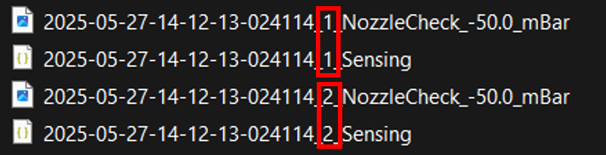
Data structure
2 folders:
Gradually lowering: ranging from -50 mBar to -88 mBar
Gradually increasing: ranging from -50 mBar to -44 mBar
Each folder contains 2 json files and 2 images for the same pressure value
The dataset will be separated into 4 parts:
Lowering_1 Increasing_1
Lowering_2 Increasing_2

Slide 4
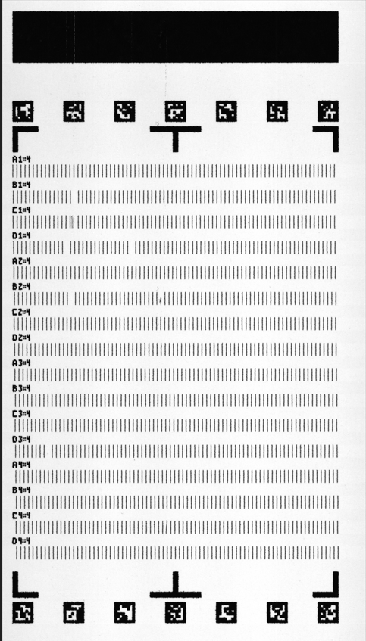
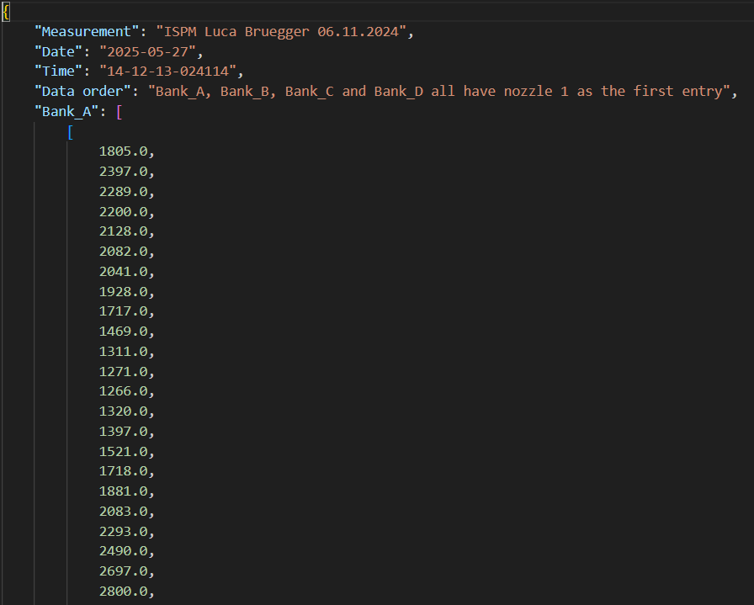
Data structure
- 4 banks of 320 nozzles each
- Each nozzle and it’s corresponding printed pattern has 124 values

Slide 5
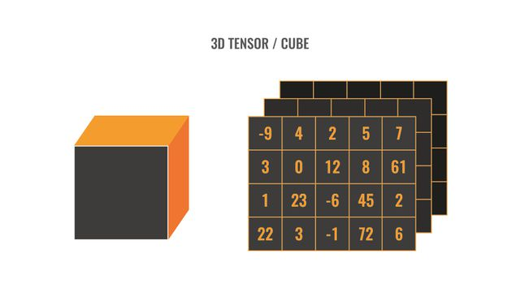
Data structure
We combine all the json files for each pressure level into a 3D-tensor
We take Lowering_1 as an example: 1280 nozzle × 95 pressure × 124 sample
Sample (the 124 values for each printed pattern)
Pressure (-50 till -88 mBar)
Nozzle (A1- D320)

Slide 6
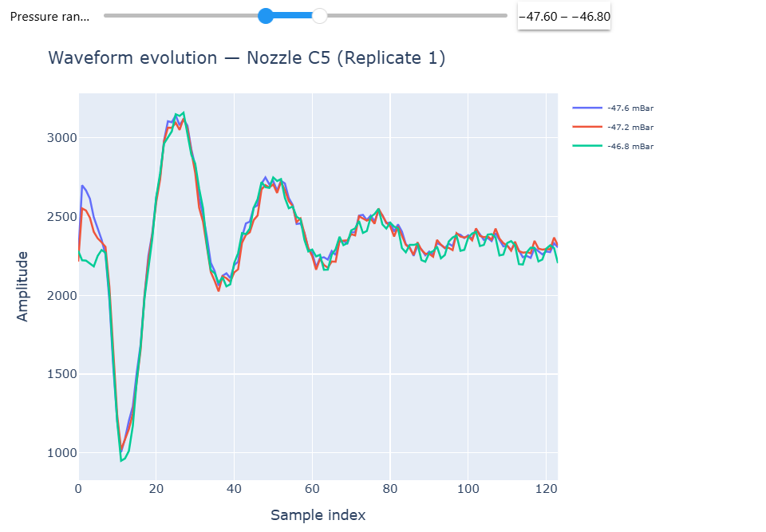
Data structure
"Sensing_Sampling_Frequency_Hz": 4125000 (0.24 ms per sample)

Slide 7
Feature extraction
54 calculated features per waveform:
Time-domain (36) → W0_*, W1_*, W2_*, W3_* with stats: mean, std, rms, p2p, absmax, skew, kurt, absarea, zcr
Frequency (6) → spec_centroid, dom_freq, band_0, band_1, band_2, band_3
(bands from: 0–80k, 80–200k, 200–600k, 600k–1.5M Hz)
Discrete Cosine Transform - DCT (12) → dct_0 … dct_11

Slide 8
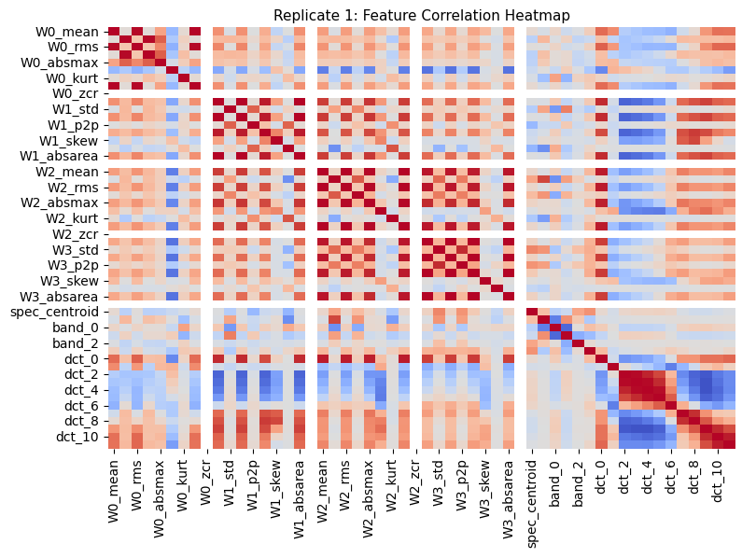
Feature extraction
Dropped features for Replicate 1 (threshold > 0.9):
Time-domain
W0: rms, p2p, absarea
W1: rms, absmax, absarea
W2: rms, absmax, absarea
W3: mean, rms, p2p, absmax, absarea
Frequency
(none dropped)
DCT
dct_0, dct_3, dct_4, dct_5, dct_8, dct_9, dct_10, dct_11
Total dropped: 22 features.
Remaining: 32 features.

Slide 9
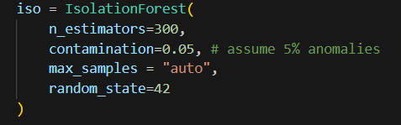
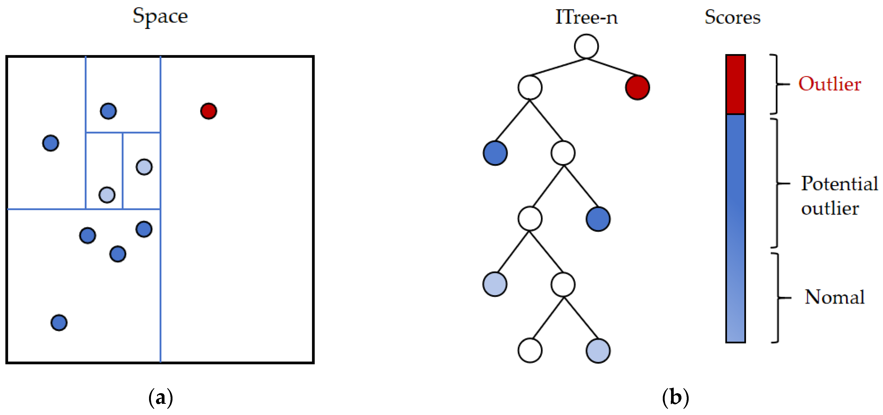
Isolation Forest explanation
In Isolation Forest, every point ends in a leaf; what flags anomalies is consistently short average path length across many random trees.

Slide 10
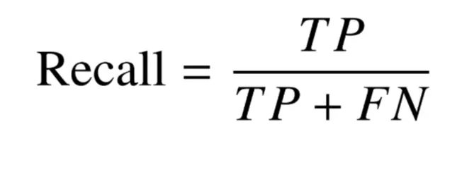
Benchmark
Recall (True positive ratio)
What other metrics could we use for benchmarking ?

Slide 11
Model optimization

Slide 12
What to look out for next week
Labeled data: optimize at precision and recall scores
Studying the features that affects the anomlay score the most
Looking at the relation between false negatives at lower pressure and true négatives at higher pressures

